Slide 1

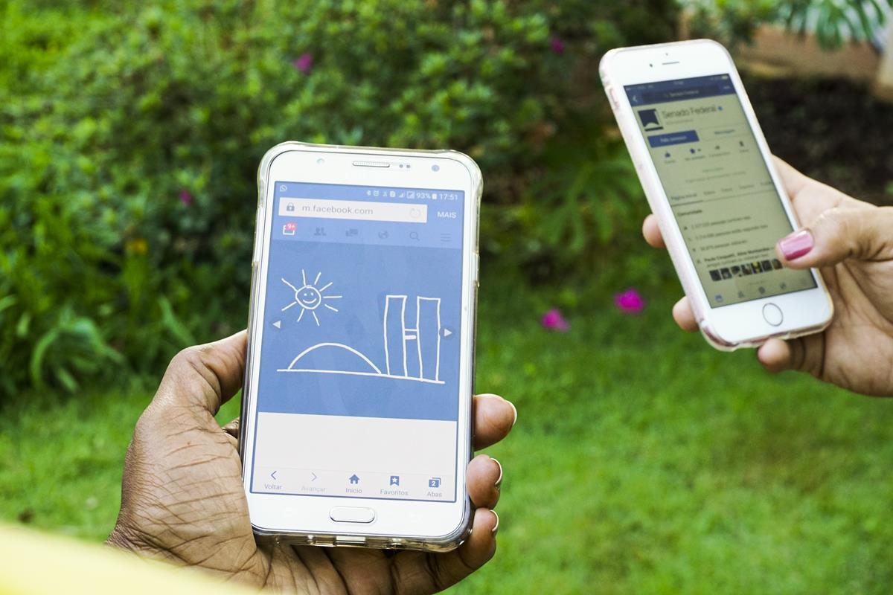
Predicting Human Activities using smartphones
(Data Science Capstone)

Slide 2
Presentation Flow
Explore the research question
Discuss the Dataset Chosen
Identify the Purpose of the Study
Exploratory analysis of Data
Classification Models Explored
Concluding Remarks

Slide 3
What Does Your Smartphone Know About You?

Slide 4
About Dataset
The Human Activity Recognition database was built from the recordings of 30 study participants performing activities of daily living (ADL) while carrying a waist-mounted smartphone with embedded inertial sensors.
Attribute information :
Triaxial acceleration from the accelerometer (total acceleration) and the estimated body acceleration.
Triaxial Angular velocity from the gyroscope.
A 561-feature vector with time and frequency domain variables.
Its activity label.
An identifier of the subject who carried out the experiment.

Slide 5
the Purpose of the Study
To classify activities into one of the six activities performed.
Tracking Human Activities :
WALKING
WALKING_UPSTAIRS
WALKING_DOWNSTAIRS
SITTING
STANDING
LAYING

Slide 6
Exploratory analysis of Data
Mainly there are 'acceleration' and 'gyroscope' features. A few 'gravity' features as well.
Total 563 features
Except ’Activity' and 'subject' features there is only numerical data. Fortunately there are no missing values.
The features seem to have a main name and some information on how they have been computed attached
Data: https://www.kaggle.com/morrisb/what-does-your-smartphone-know-about-you/data

Slide 7
Data Analysis
Disregarding the possibility of flawed data, the participants seem to walk roughly 10% faster downwards.

Slide 12
Classification Models
Before PCA
After PCA

Slide 13
Conclusion after PCA
Data analysis shows that PCA is not helping to improve model accuracy as there must be some loss of information so we are not considering PCA for improving model performance
The best performing model is Logistic Regression with improved performance after tuning and accuracy of 98%
Vanilla gradient boosting without tuning performed the best, with tuning it didn't help much
Logistic Regression is way faster than Gradient boosting

Slide 14
Gradient Boosting Classifier

Slide 15
Logistic Regression

Slide 16
Concluding Remarks
The smartphone has enough data to determine what its user is doing (98%: 6 activities)
Logistic Regression is giving more accurate and improved performance compared to other classification models also faster compared to gradient boost
This data can be used by many healthcare and fitness apps which can provide more insights
As the dataset only provide a small amount of data the variance of the results can be high

